Slide 1

Forecasting Power Supply Demand
<Team >
<Mentors > Mr. Rajshekar and Pallavi
<21/Mar/23>

Slide 2
Business Problem:
PJM Hourly Energy Consumption Data
PJM Interconnection LLC (PJM) is a regional transmission organization (RTO) in the United States. It is part of the Eastern Interconnection grid operating an electric transmission system serving all or parts of Delaware, Illinois, Indiana, Kentucky, Maryland, Michigan, New Jersey, North Carolina, Ohio, Pennsylvania, Tennessee, Virginia, West Virginia, and the District of Columbia.
Objective:
Split the last year into a test set- can you build a model to predict energy consumption?
Find trends in energy consumption around hours of the day, holidays, or long term trends?
Understand how daily trends change depending of the time of year. Summer trends are very different than winter trends.
Forecast for next 30 days.

Slide 3
Project Architecture / Project Flow

Slide 5
Exploratory Data Analysis (EDA) and
Feature Engineering

Slide 6
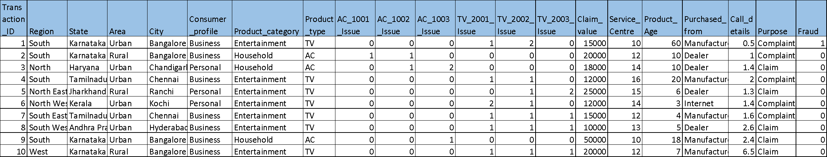
Data set details
Example
How many rows, columns and unique values
Date ranges
Missing values
Etc..

Slide 7
Exploratory Data Analysis (EDA)
71.87% of all the loans are two wheeler
TN, Gujarat, AP one (Telengana), Karnataka, Maharashtra contribute to 87% of total defaults; Central, Orissa, UP, each have less than 7% defaults
List out all your queries:
CustNetOutflow & CustDisbursementAmt has ‘0’ & negative values ?? Can it be?
CustFinanInterest 7800 entries out of 35k entries have interest rate < 1%

Slide 8

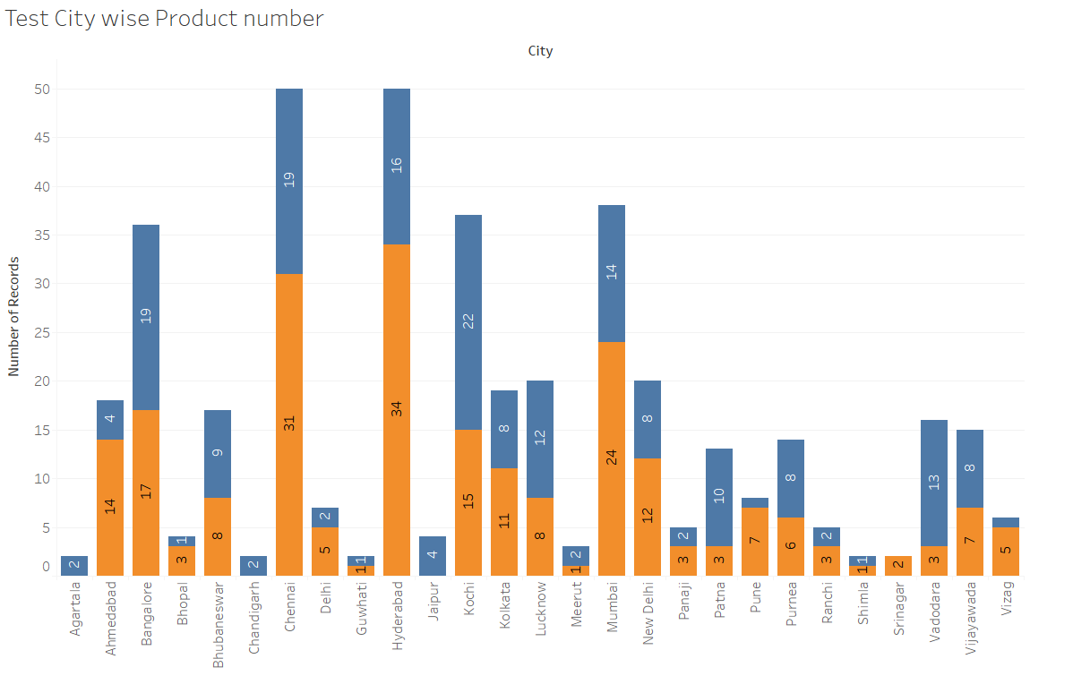
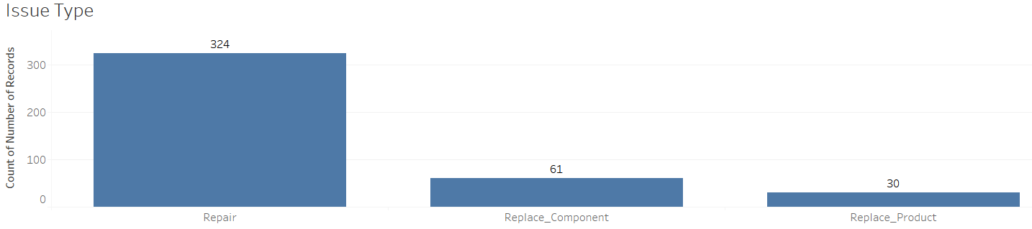
EDA
Look for problems in the data such as class imbalance, missing values, impossible values, and patterns ,similarities, distributions etcs..
Treat all the problems with appropriate techniques

Slide 9
Feature Engineering

Slide 10
Model Building

Slide 11
Template for Model results presentation
Model - SVM
Algorithms
Data set details
Algorithm details and configuration
Data Partition details
Accuracy:
Class wise accuracies
Recall
Precision
F1 score
Etc..

Slide 12
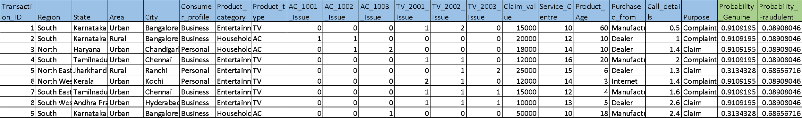
Model Predictions
Predicted probabilities for each transaction
Example
Transaction data fed to the model

Slide 13
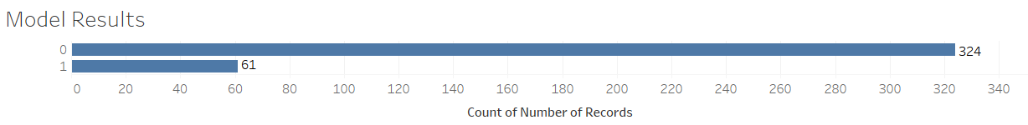
Model Results
Example
Model generated the output for the transaction data set in which 324 transactions are genuine(0) claims and 61 transaction are fraudulent(1)

Slide 14
Model Deployment using R shiny / Flask or any other method

Slide 15
Challenges faced?
How did you overcome?

Slide 16
Thank you

